Slide 1
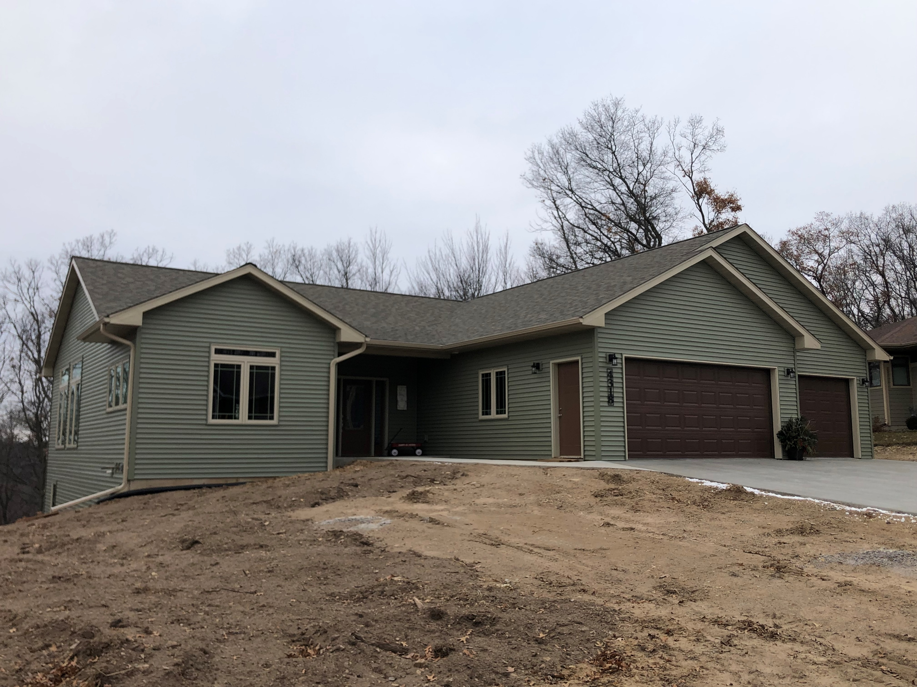

Slide 2
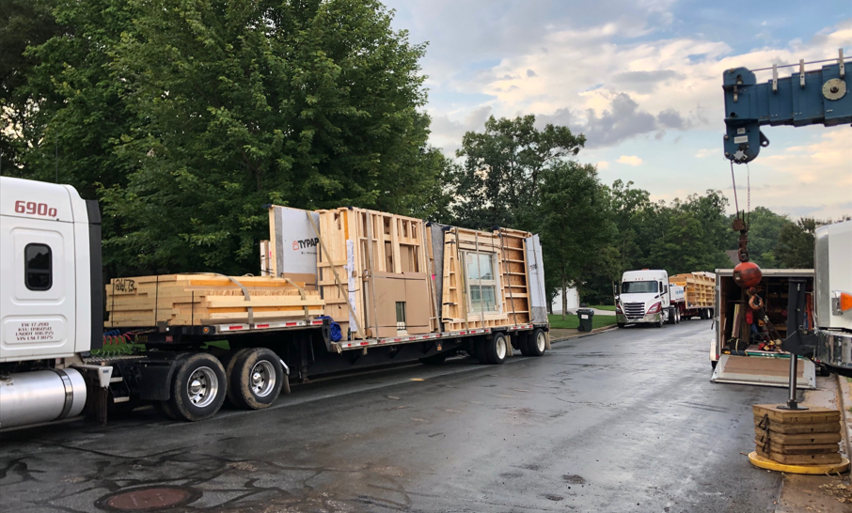
THIS IS HOW WE START THE PROCESS
Morning of the “set”; the crane is on site and the first trucks are staged, exterior walls in the foreground and floor panels in the back grounD
let’s start building that new home!

Slide 3
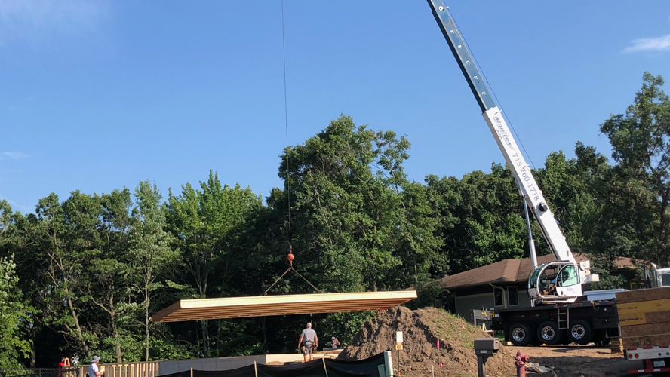
FLOOR PANEL #1 IS BEING LIFTED INTO PLACE
Yes we panelize the floor system too.
Whether it’s 2x10 or 2x12s, floor trusses or I-joists like this one. The panels are built with floor sheathing glued and nailed along with any blocking, and the panels are even designed around the stair way openings!

Slide 4
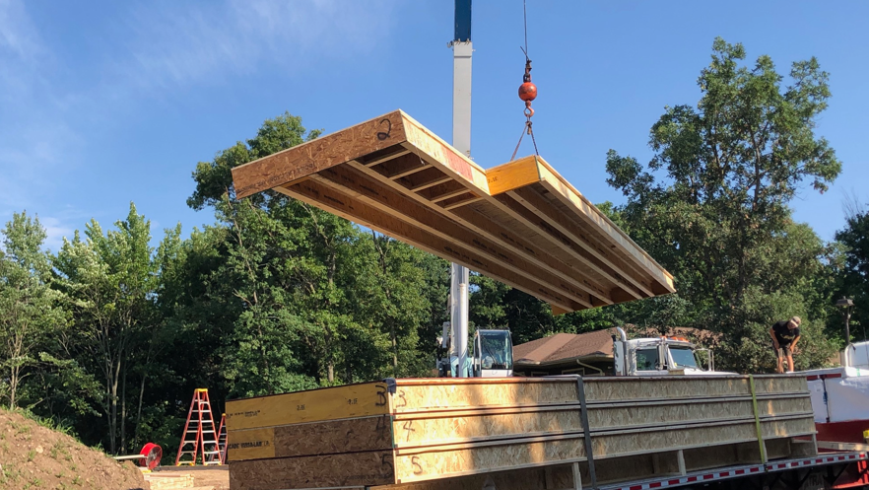
HERE COMES FLOOR PANEL #2
Here Comes floor Panel #2; notice the built in notch to follow the jog in the foundation. You can also see the install perpendicular blocking as required by code. This panel will slip into the groove of the subfloor on panel #1 subfloor…a simple bead of construction adhesive along that seam and then nail into place.

Slide 5
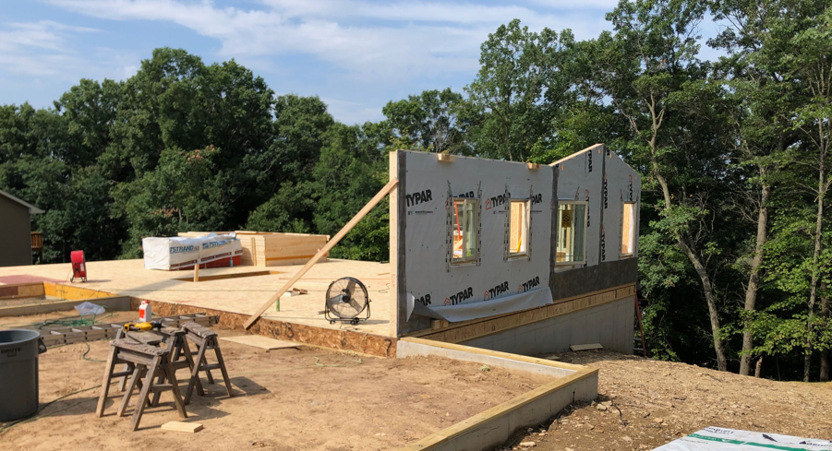
LATER THE SAME MORNING, WE ARE SETTING THE EXTERIOR WALLS
the exterior walls are framed in, with all the openings for windows and exterior doors. House wrap installed, stapled off, and folded into those openings. Windows installed, squared and plumbed, along with the weather-proof tape…talk about efficiency!

Slide 6
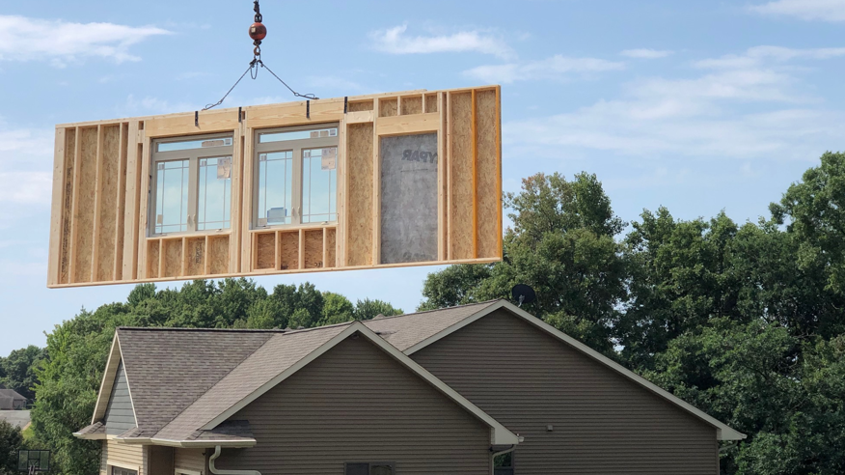
THE INTERIOR SIDE OF THE EXTERIOR WALLS!
Talk about planning. Headers, perpendicular partition and curtain rod blocking already installed and ready to go!

Slide 7
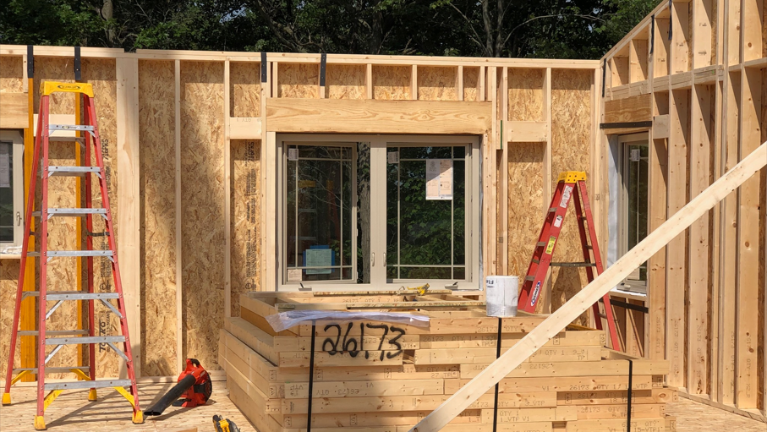
ALL THE EXTERIOR WALLS ARE SET LET’S START ON THE INTERIOR WALLS.
The interior walls are bundled together and set as a pack on the inside of the building; just need to remove the straps and carry into place!

Slide 8
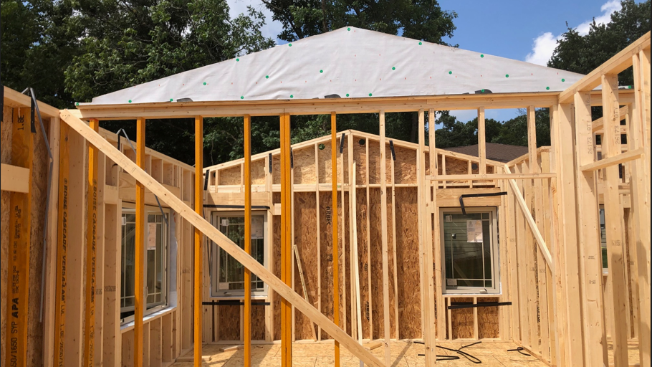
TIME FOR THE DETAILS
Exterior walls on the interior, to close off the attic areas from the main ceiling areas along vaulted ceiling rooms.
Engineered lvl studs along areas for cabinetry or per your specifications.

Slide 9
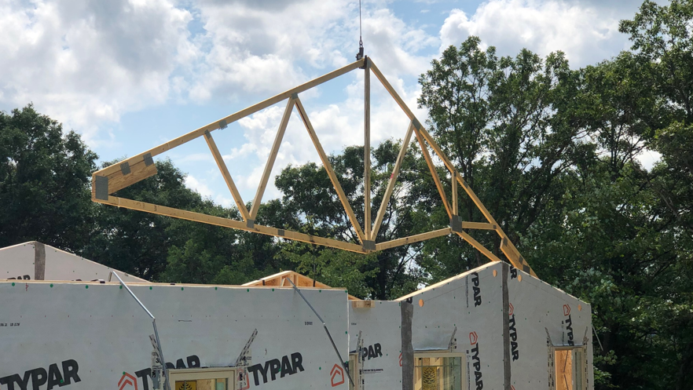
LATER THAT AFTERNOON SAME DAY
Time to set the roof trusses. this truss has a vault that corresponds with the balloon framed raked wall on the exterior.

Slide 10
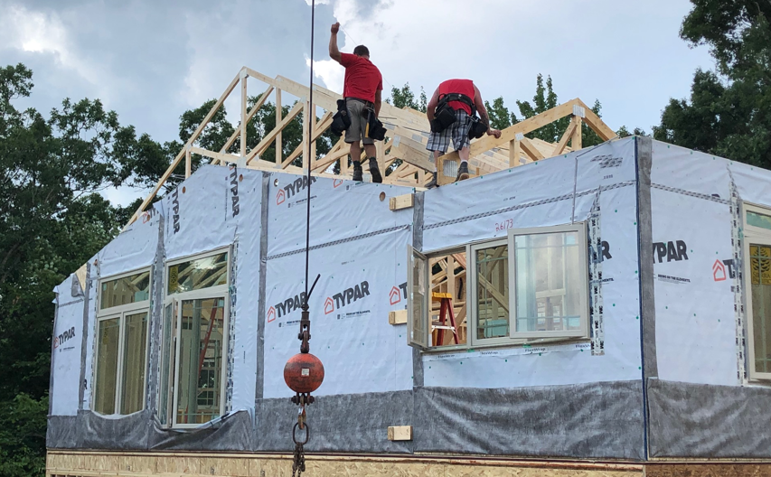
GETTING CLOSE THE END OF DAY ONE
Just a end gable and the front truss area left to set.

Slide 11
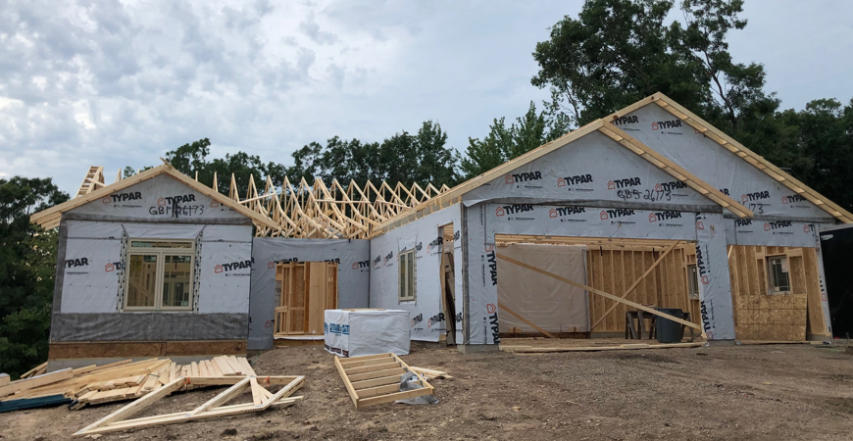
DAY ONE IS OVER, LOOK AT THE PROGRESS!
THE GABLES HAVE SHEATHING AND HOUSE WRAP APPLIED; THE RAKE ENDS ARE PREBUILT AND INSTALLED BEFORE THE GABLES ARE SET.

Slide 12
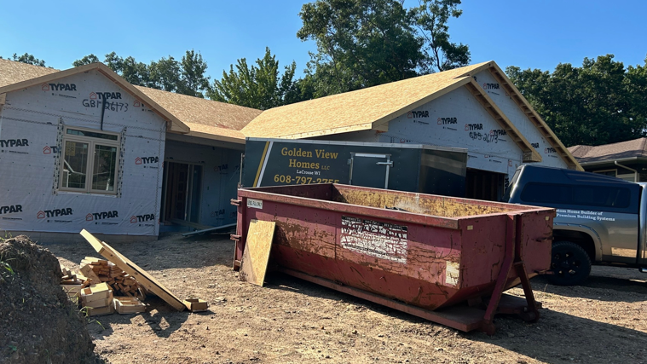
DAY 3: ROOF IS SHEATHED OFF AND THE MECH ROUGH INS ARE IN THE WORKS!
THE ROOF FRAMING IS COMPLETE; SHEATHING, SUBFASCIA, BOXED IN GABLES AND TRUSSES BRACED PER SEALED ENGINEERED DRAWINGS SUPPLIED BY STERLING PREMIUM BUILDING SYSTEMS.

